Slide 1
Natural Language Processing DTS305TC
Huakang Li
Huakang.li@xjtlu.edu.cn
School of AI and Advanced Computing
Notes:
English Title: Uppercase, Calibri size 60, XJTLU Navy
English Subtitle: Uppercase, Calibri size 36, XJTLU Navy

Slide 2
Overview
NLTK
Tokenization
Stemming
Lemmatization
Stop Words Removal
Exercises

Slide 3
Natural language Toolkit [nltk]
Open source python modules and linguistic data for Natural Language Processing application
Supports classification, tokenization, stemming, tagging, parsing, etc.
To install nltk: pip install nltk

Slide 4
Tokenization
Tokenization is the process of segmenting a chunk of continuous text into separate entities called “tokens”.
Why?
Foundation of Text Processing:
Before analyzing text, it needs to be broken down to make sense.
Helps convert unstructured data into a structured form.
Enables further Processing:
Each token can be further processed – stemmed, lemmatized, tagged, etc.
Improves Text Retrieval:
Search engines use tokenization to index and retrieve documents.

Slide 5

Tokenization - Demo
Import libraries
Download the required NLTK data package

Slide 6


Tokenization - Demo
Sample Text
Sentence Tokenization
Result

Slide 7

Tokenization - Demo
Sample Text
Word Tokenization
Result

Slide 8

Tokenization - Demo
Removing Punctuation
Result

Slide 9
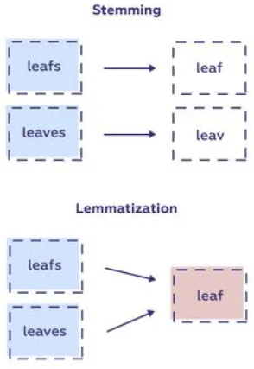
Stemming vs lemmatization
Stemming removes common suffixes from the end of word tokens
lemmatization ensures the output word is an existing normalized form of the word

Slide 10
Common stemming algorithms
Porter Stemmer:
One of the oldest and widely used algorithms.
Lancaster Stemmer:
More aggressive than the Porter Stemmer (tends to over stem).
Snowball Stemmer:
Supports multiple languages.
Improvement over the Porter Stemmer.

Slide 11
Stemming
Overstemming:
Too much of word clipping can lead to loss of meaning.
Example: "university" => "univers".
Understemming:
Insufficient reduction and multiple stems for the same root.
Example: "data" and "datum" stemming to different roots.

Slide 12
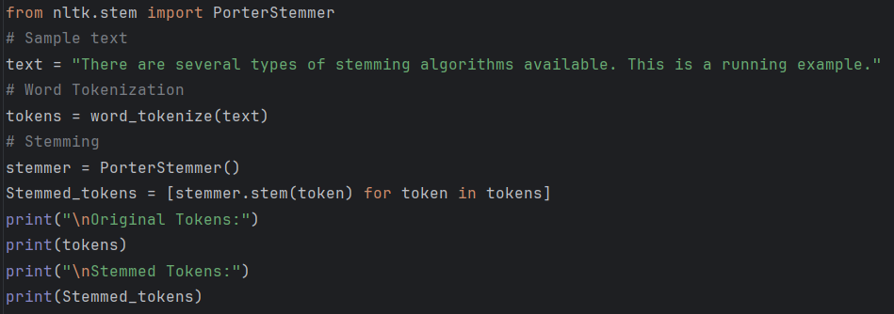
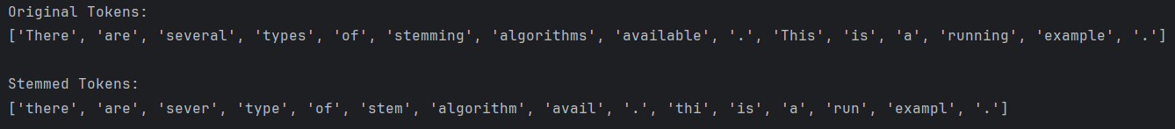
Stemming Demo
Stemming:
Result:

Slide 13
Lemmatization
The word "meeting" can be either the base form of a noun or a form of a verb ("to meet") depending on the context
e.g., "in our last meeting" or "We are meeting again tomorrow".
Unlike stemming, lemmatization attempts to select the correct lemma depending on the context.

Slide 14
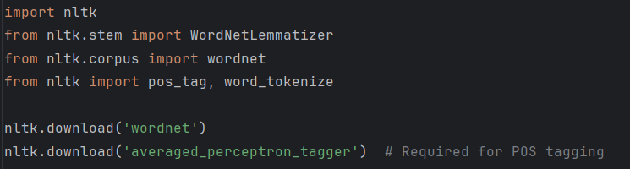
Lemmatization - demo
Import libraries

Slide 15
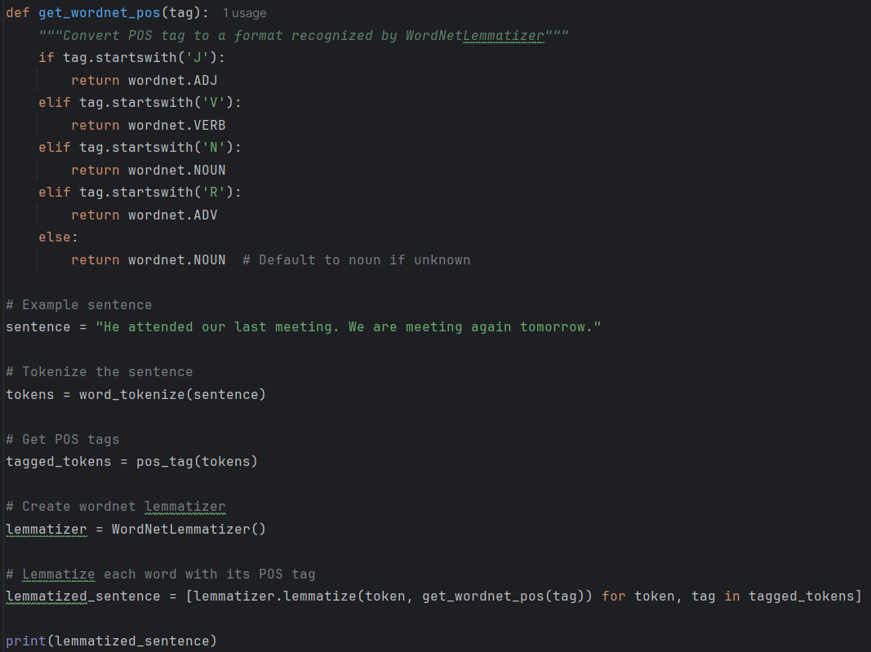
Lemmatization - demo

Slide 16
Lemmatization - demo
Sample text
Result

Slide 17
Stop words
Removing stop words is a common preprocessing step to improve the performance of text analysis.
They usually do not carry significant meaning and can be removed from the text to reduce noise in the data.
Stop words are common words like "and," "the," "is," etc.,

Slide 18
Customizing Stop words
Domain-Specific Terms: In some fields, certain generic words might have importance.
Example: "virus" in general texts vs. biomedical texts.
Tailoring for Analysis: Some tasks might require retaining specific stop words.
Challenges:
Some stop words can be crucial in certain contexts.
Example: "To be or not to be" — "to" and "be" are both stop words but are central to the phrase.

Slide 19
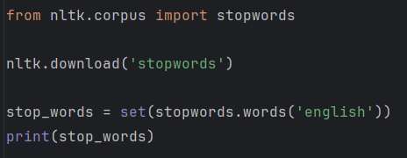
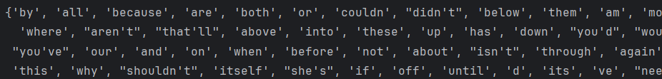
Remove Stop Words - demo
Import, download and view stop words
Result

Slide 20

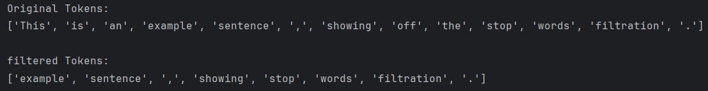
Remove Stop Words - demo
Remove Stop Words
Result

Slide 21
Exercise 1:
Given the following paragraph: “Natural language processing (NLP) is an interdisciplinary subfield of computer science and artificial intelligence. It is primarily concerned with providing computers with the ability to process data encoded in natural language and is thus closely related to information retrieval, knowledge representation and computational linguistics, a subfield of linguistics.”
Task: Perform all necessary text preprocessing steps.

Slide 22
Exercise 2:
Please use Internet resources to find 3 text classification datasets. The requirements are:
1. The dataset should ideally have no less than 2000 sample instance
2. Each data instance requires at least 1 column of text content and 1 column of label content
3. Try to find one copy of txt, one copy of csv, and one copy of json data.
Tasks:
1. understand how to read and write files using python
2. Perform necessary text preprocessing steps for the datasets.

Slide 23
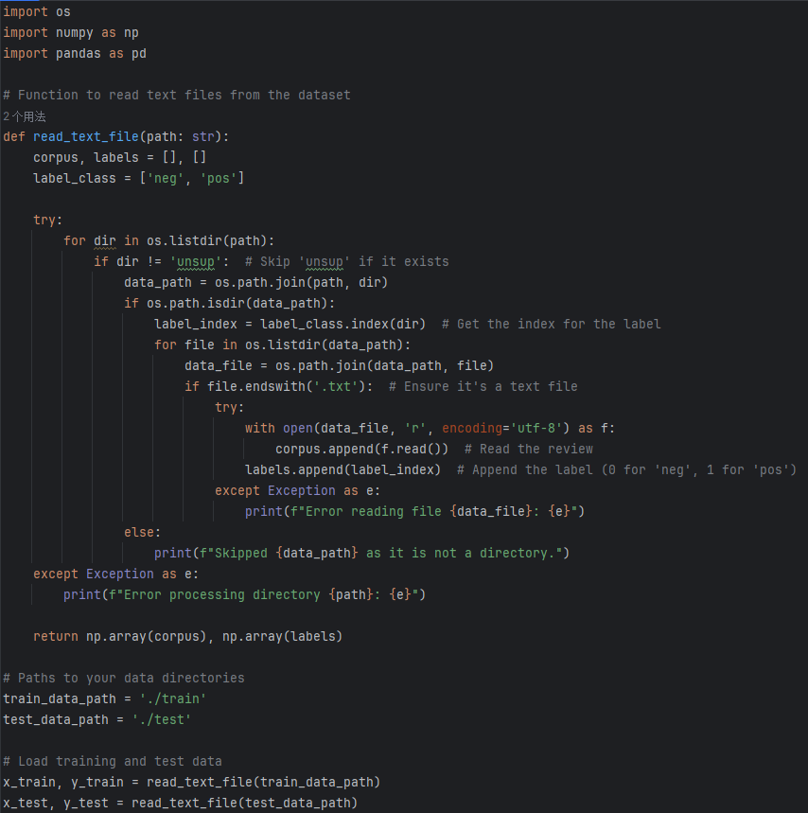
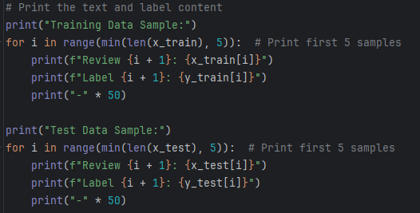
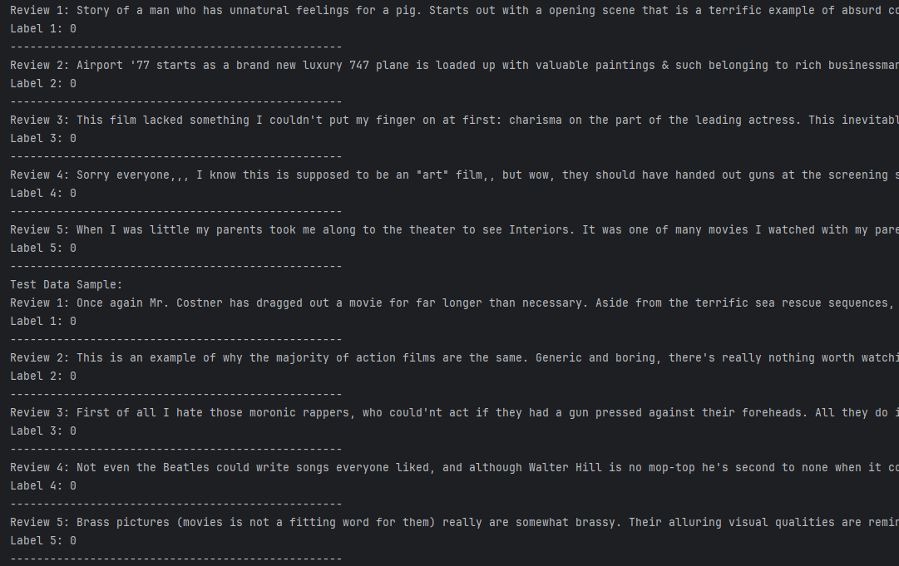
Solution-1
Read the txt format dataset
Print the content and label examples
Output

Slide 24
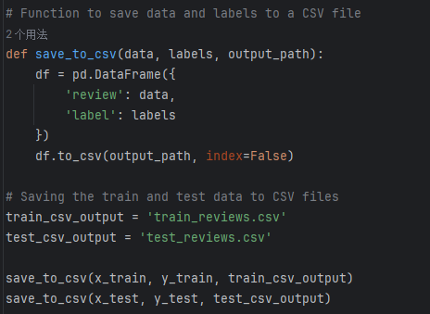
Solution-1
Save to csv

Slide 25
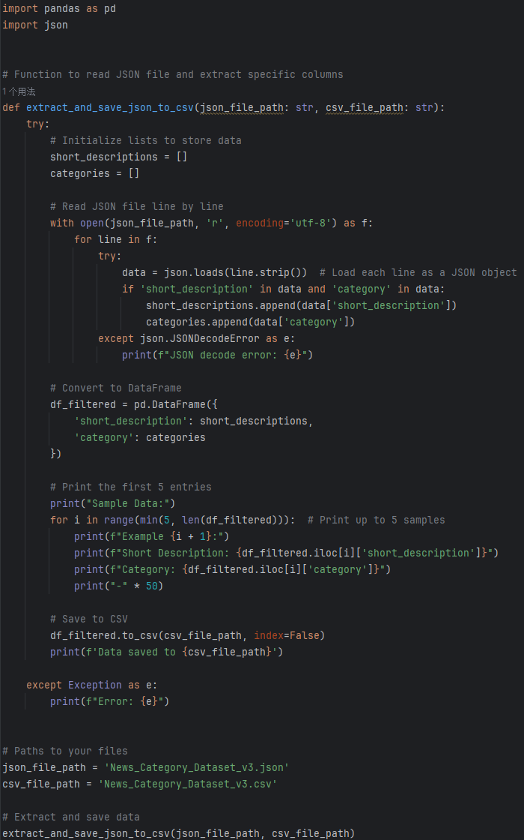
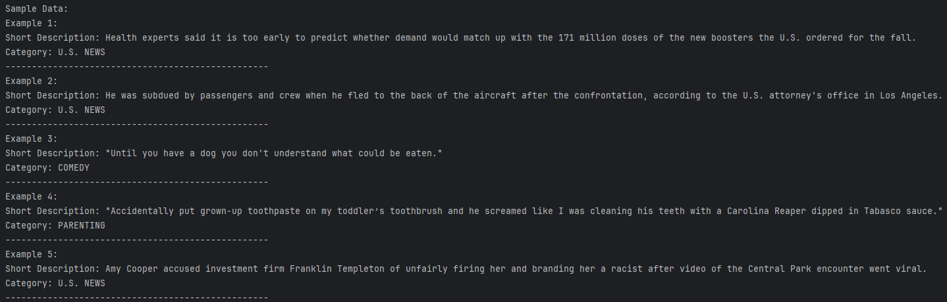
Solution-2
Read the Json format dataset
Output

Slide 26

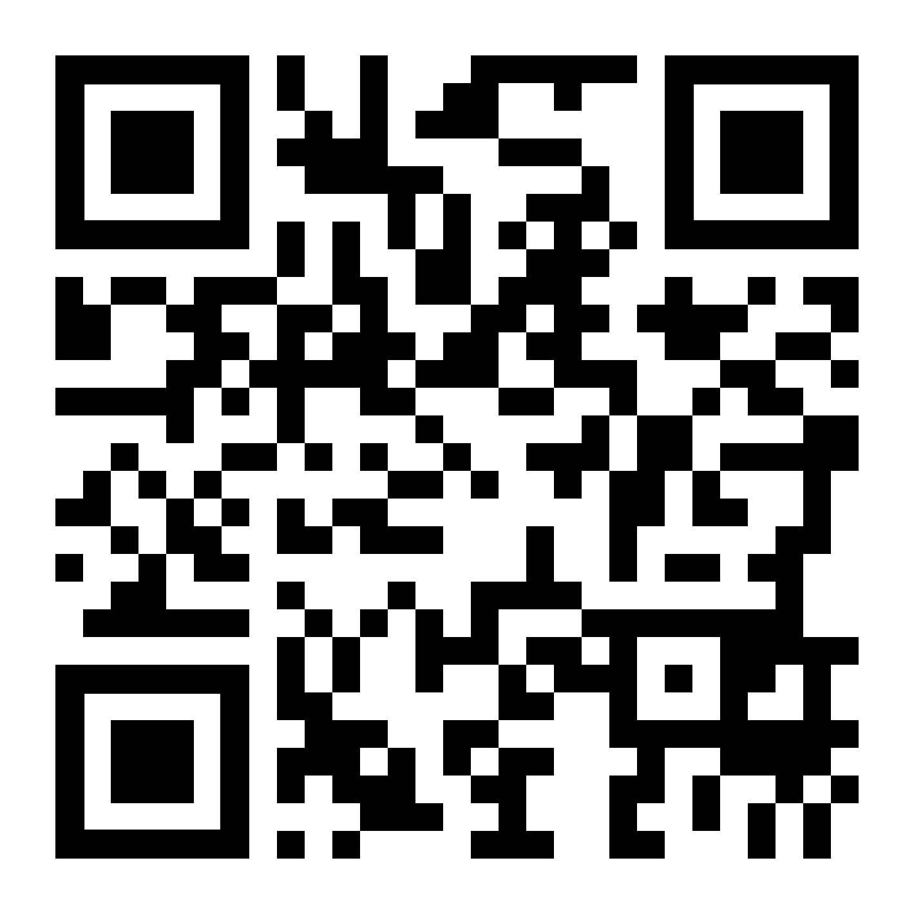

THANK YOU
Visit us
FOLLOW us
www.xjtlu.edu.cn
Notes:
Title: Uppercase, Calibri size 60, XJTLU Navy

